Slide 1
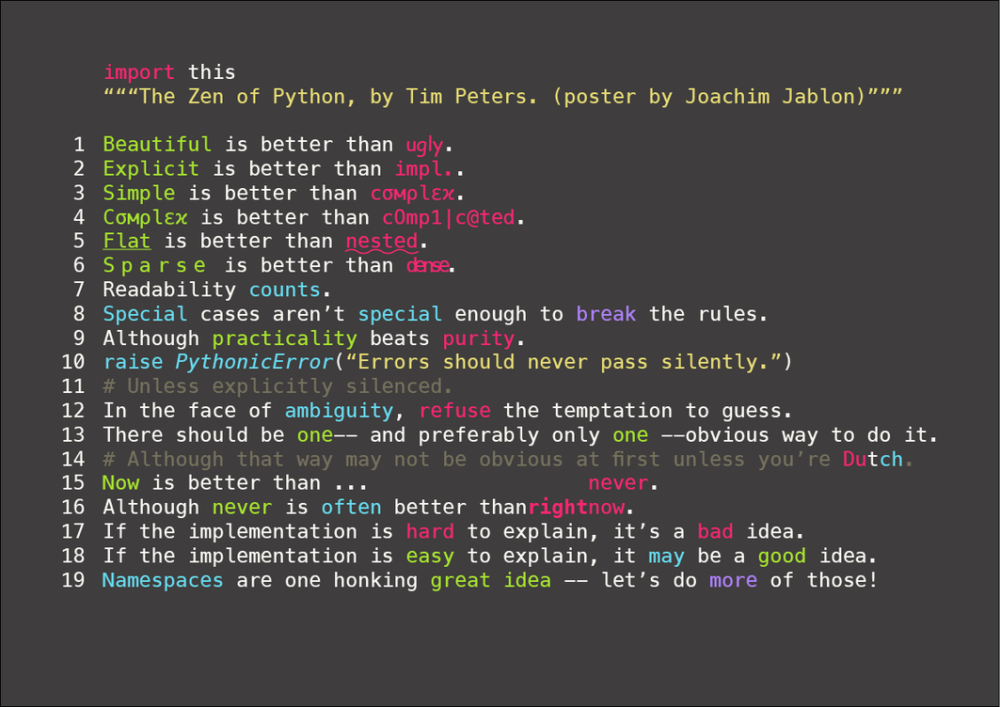

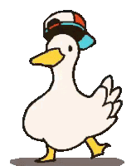

Notes:
** Put a question in chat to see the experience level of participants:
“Never programmed before.”
“Dabbled in programming but not efficient in any language.”
“Efficient in a programming language other than Python.”
“Somewhat knowledge about Python but want to level up my skills.”
“Knowledgeable about Python but came to see what’s happening in the course.”
**
The “Zen of Python” is 19 guiding principles for writing computer programs that influence/influenced the design of the Python programming language.
Cool, lets get into it shall we?
______
Good songs to play while waiting to start:
Pharrel Williams Happy
Hungry like the wolf duran duran
We can work it out beatles
Ratata loud pipes
> Natasha Bedingfield - Unwritten
Imagine Dragons - On Top Of The World
Day 2:
Iko Iko
9-5
pep8 song

Slide 2



Book Writing 101
An Introductory course
Notes:
Welcome to book writing 101! Where we learn how to write books which are up to snuff with modern practices!
… well I guess this is technically what I am teaching during this learning hack, but the true title is a little different isn’t it?

Slide 3
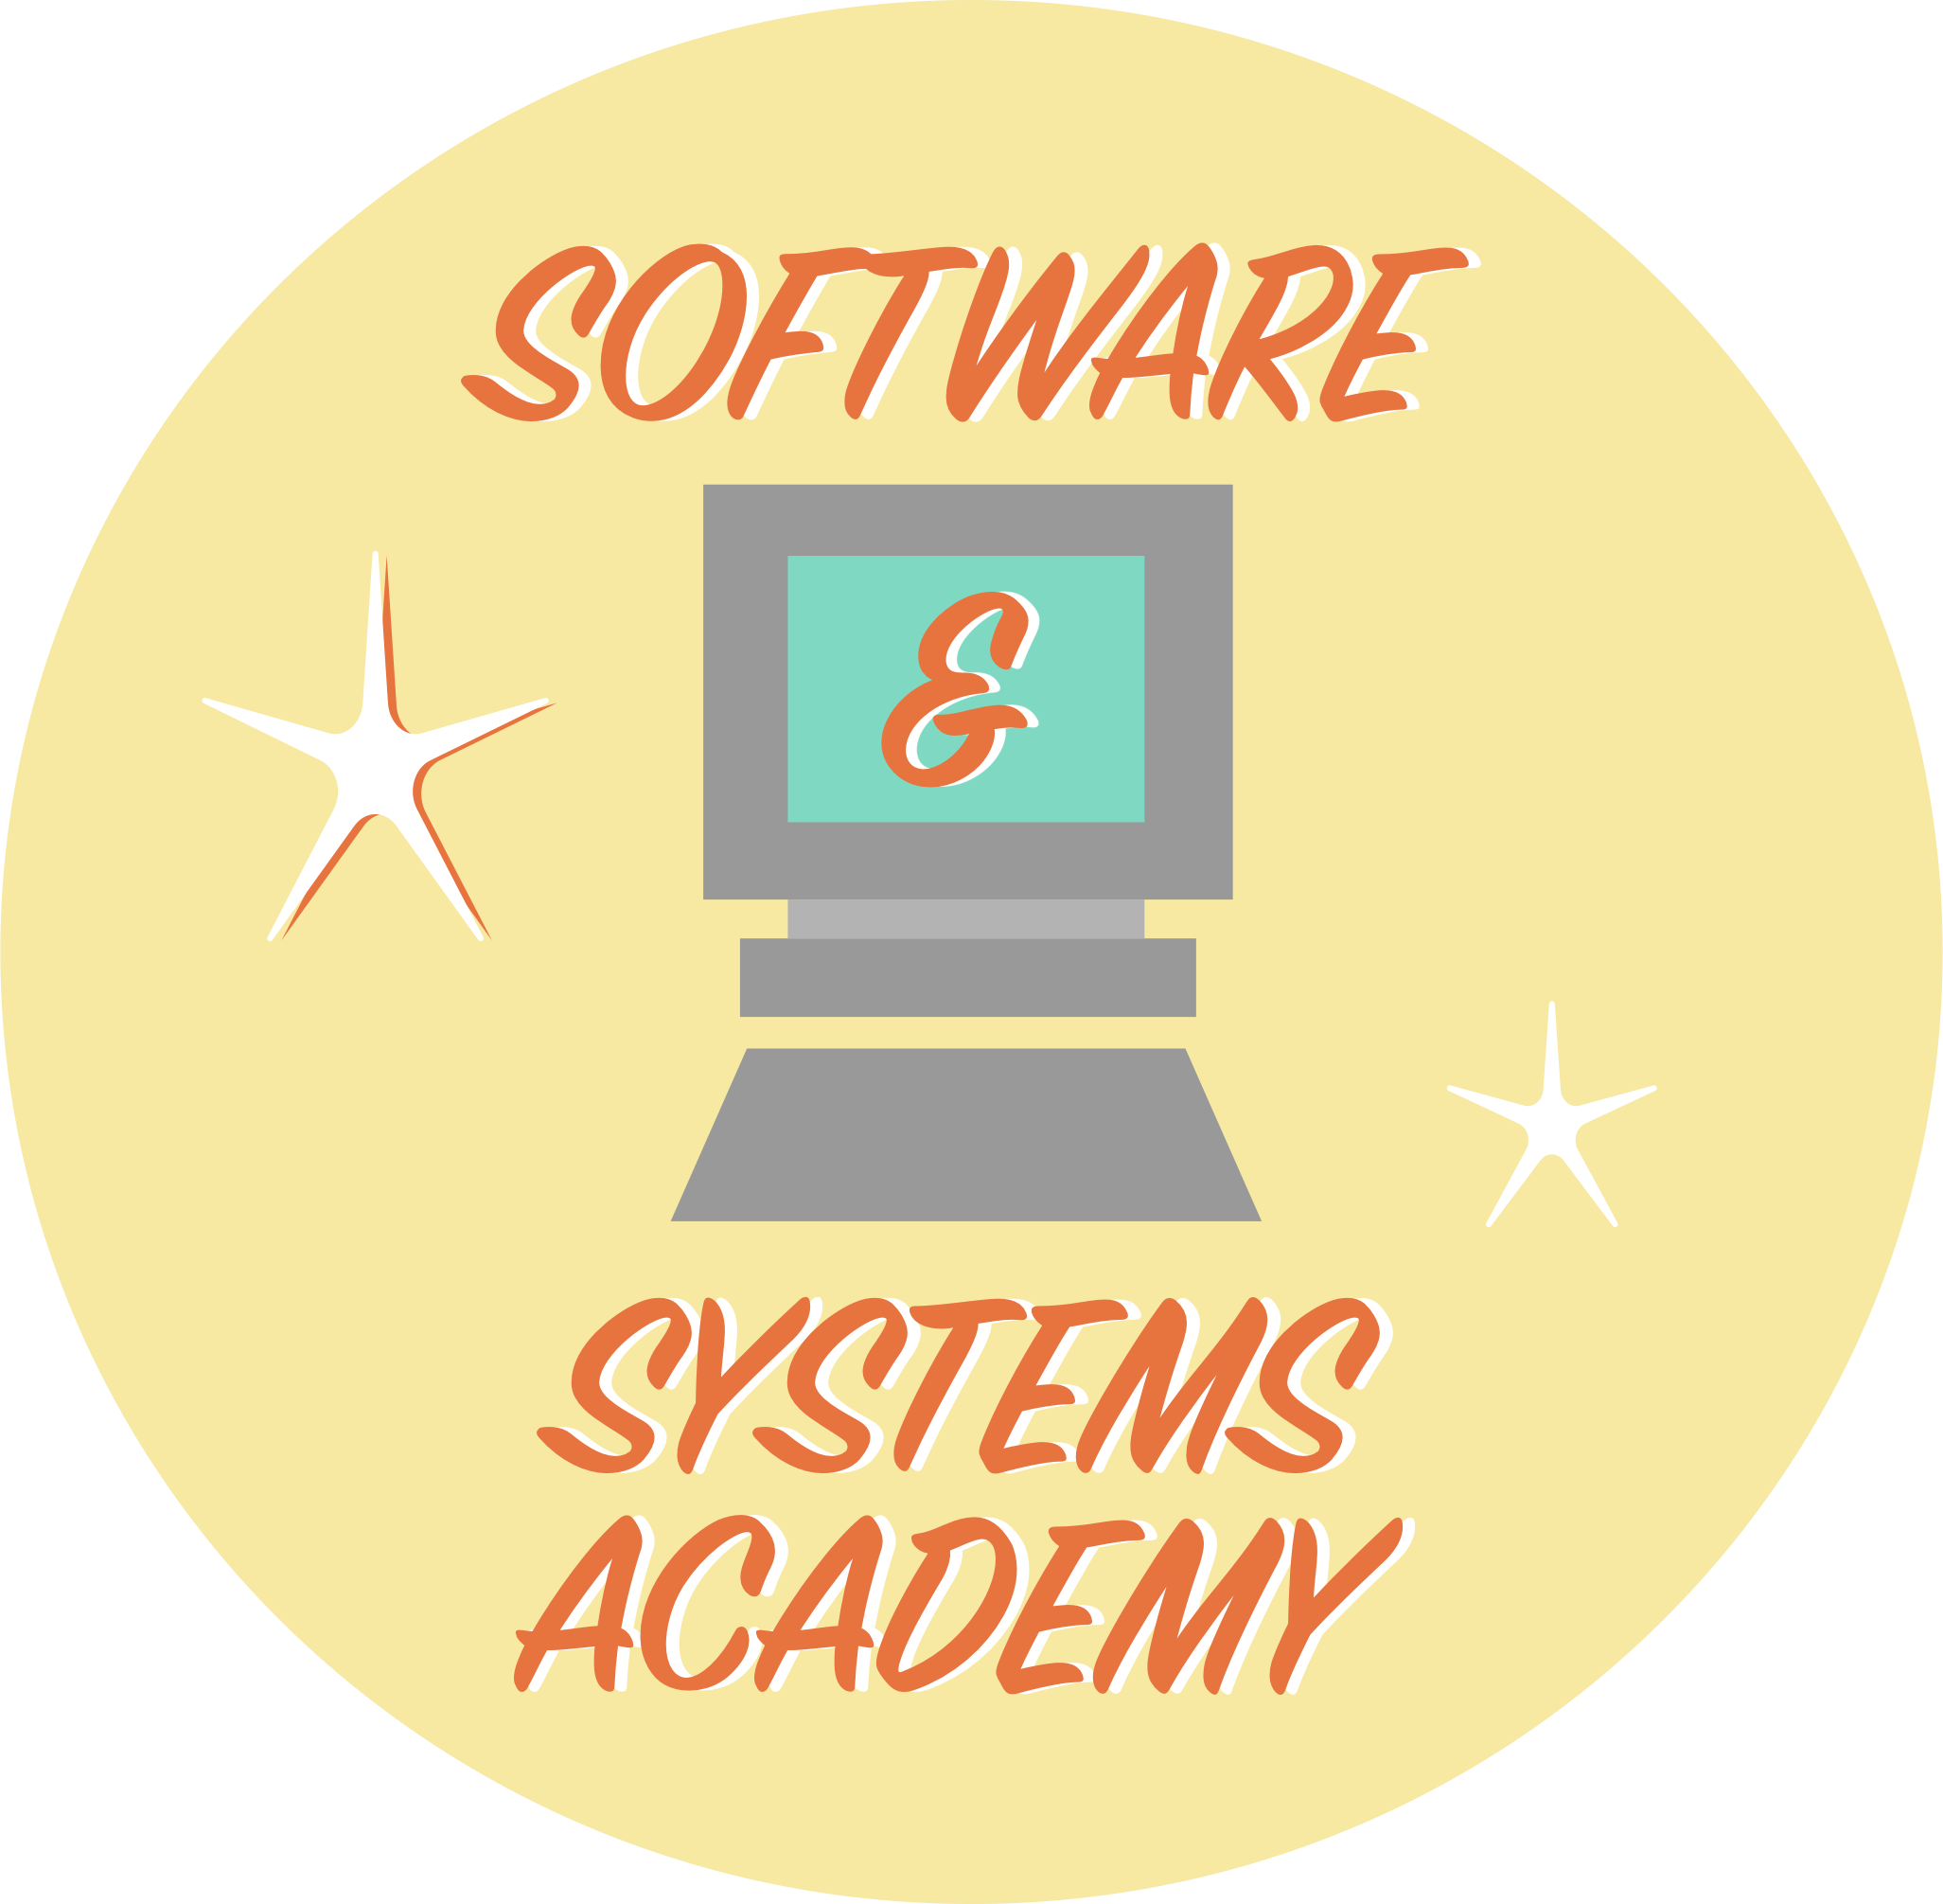

Python 101
An Introductory course
Notes:
This learning hack is Python 101. Welcome! Hope you are in the right spot.
This learning hack is designed to teach the absolute basics of python programming. To some this class may be way to slow, to others it may seem to go to fast, but I encourage you to take a deep breath, relax, and learn at your own pace.
I leave a lot of time to absorb the info on slides and you also have plenty of time to learn it firsthand on the exercises or breakout sessions. I also cover some advanced topics at a high level that some programmers are negligent about.
This course works best if you ask questions. I am going to try to leverage the “raise hand” functionality in teams for this. When you have a question (at any time) raise your hand (please wait to be called on). When I call on you, I will lower your hand so you can ask again if needed. Feel free to ask to go back a couple slides when asking your question.
I purposefully will leave times of awkward silence so that people can read slides, understand the content, and raise questions they may have by raising their hand.
This course consists of slides to teach concepts and programming problems to put those concepts into use. I could show you 100 slides but you won’t remember a thing unless you get your hands dirty and figure it out how to do it on your own.
So why did I have a “Book Wiriting 101” slide as my opening slide?
My last slide was partially a joke but there is an uncanny amount of truth to that slide and what programming is. Programmers are book writers, we write books in a specific language which the computer can read. The computer is a dang good reader with perfect memory recall; however, it has very specific grammar that we must obey and it will not react kindly to typos.
The reason programming is hard is because you are basically learning a new language just like if you were learning Spanish. You won’t be perfectly fluent after this hack, but the goal is to give you the foundations you need to continue learning under your own effort and to Google search the stuff you don’t know. It is kinda hard to Google search something without know the right term (trust me).
Theoretical question, if I gave you fictional novel that was 500 pages long, how long would it take you to explain the personality of the main characters mother? It takes time to understand a book because you need to start reading from the beginning. On top of that, you also need to understand the words in the book. I don’t think handing an organic chemistry book too an 8-year-old will be very productive since they can barely understand the words in the book even if it’s written in their primary language.
Coding is no different in this analogy. Programming takes time, practice, and a lot of failure.
Reminder, if you see something interesting in the slides that you don’t fully understand and I don’t fully explain, raise your hand.
Some slides may suffer from the “Chicken or the Egg” problem. In order to explain something, I may have to introduce a topic that I have not yet to explained.
The coding problems are designed such that you can do them as I talk but after each section, we will take a ~10-15-minute break to work on the problem (sometimes longer). After the programming problem, I may show how I would solve the problem just to have it in the recording but this is TBD. At the beginning of each section, I will give you time to read the up coming problem so you know what to expect.
Lastly, for non coders, coding is super powerful for repetitive tasks, not just math. If you do something on a computer/calculator/machine in a repetitive manner, programming could make your life easier.
A couple quick notes, be careful when Googling programming problems, keep and eye out for Python2 (which is no longer supported) and Python3. A good way is to look how old the Question/Answer is and if the `print` has parantheis: https://stackoverflow.com/a/15769313/8150685
I would NOT recommend using anaconda for this workshop nor would I recommend using it for any form of development but we can get into that later if you want to know why.

Slide 4
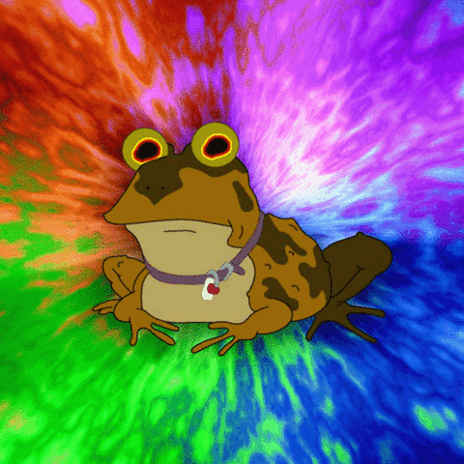
Before we get into it
Python Installation: https://www.python.org/downloads/release/python-381/
IDE (Integrated Development Environment) Installation: https://code.visualstudio.com/download
Programming Exercises: Link to come later….
Alternatively you can get python via:
Go to https://www.php.net/
Type: “I hate PHP” (try to type it fast, case matters).
Hit [Enter]
Notes:
Most of this course will be PowerPoint; however, my style of PowerPoint is a little different than most. I did PowerPoint so that I can force your attention to key aspects that I will explain.
Before diving into this, you should have done the pre-work.
This includes installing VS Code, Installing Python (and making sure it is on your PATH), and downloading the course resource, which is in this teams channel.
Installing something like a programming language can be frustrating, but don’t be afraid of failure. One thing software developers have going for them is we can make mistakes all day long for minimal material cost. If you fail, just try again. This is not something aerospace engineers can say when making planes ☺

Slide 5

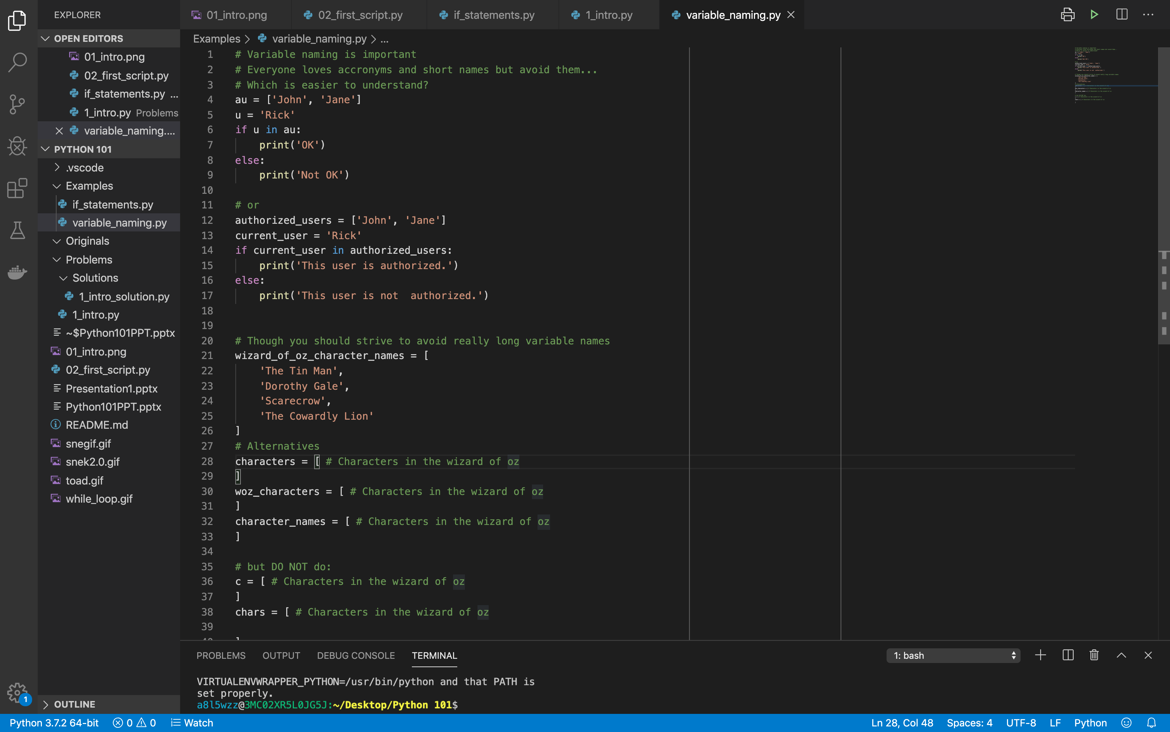
ide crash course
Please note there is almost never ONE way to do something.
Notes:
Before diving into the course. I want explain the IDE (Integrated Development Environment) which is VS Code.
I want to make sure you have the course resources, show you how to navigate them, and show you how we can do things like run code.
Just note, I will show you how to do something, but that doesn’t mean it is the only way to do it. I may just show you the easiest way instead of the fastest way. I may show you a way I prefer instead of what may actually work best for you.
There is often many right ways to do something (including when writing code) so don’t be surprised if you see someone do something a different way than you did.
(Make sure to show how to zoom in to the slideshow screenshots with VS Code).
(Explain that the Tab key is used a lot in programming).

Slide 6
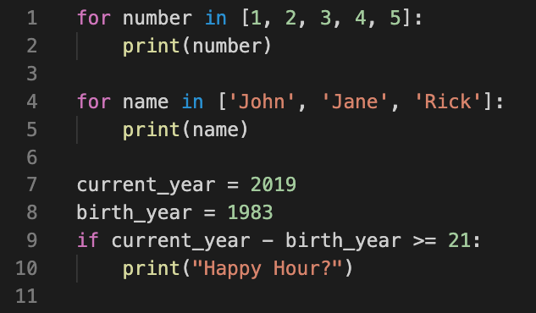
What is python?
An interpreted, object-oriented, high-level programming language.
** Interpreted means the python goes through the code line by line to execute the code
instead of having to build the entire code base to run the program. Emphasizes
readability making it easy to to learn and maintain.
Uses spaces or tabs for indentation and to create code blocks. You can choose spaces or tabs BUT you CANNOT mix and match the two.
Notes:
So what is python?
I have some code at the bottom but please don’t be scared by it. As I go through the slides, everything below will be explained in more detail.
I also use some words you may be unfamiliar with but don’t fret.
Python is a programming language just like: C++, C#, Java, JavaScript, Go, Etc.
Python is inerpreted: if a programming language is a book reader, compiled languages will read an entire book and rewrite it to be more optimized so it can read it easier in the future, this means the entire code base must work for the program to run at all.
Python on the other hand, just reads the code line by line and if it sees something it doesn’t like, it will complain and stop there unless we explicitly tell it to not worry and continue reading. This means we can run Python code to make sure the first half of the code works even if we know the second half will fail.
The object-oriented means the Python language is heavily oriented around objects which I will get into later.
Python as a language emphasis readability making it one of the easier languages to learn and work with. Take a look at the code at the bottom, you may not know what it does but can you take an educated guess **(pause for ~20 seconds so people can read it)**? Everything in that code block will be explained in due time.
Lastly, a very important point, is python uses spaces OR tabs to create blocks of code. You can choose one or the other but you cannot not mix and match and you must be consistent (if you use 4 spaces, all indents must be 4 spaces). I recommend 4-spaces. VSCode defaults to spaces for your, but some IDEs or text editors (such as notepad) will use tab characters. You will experience this firsthand in a future programming exercise.

Slide 7
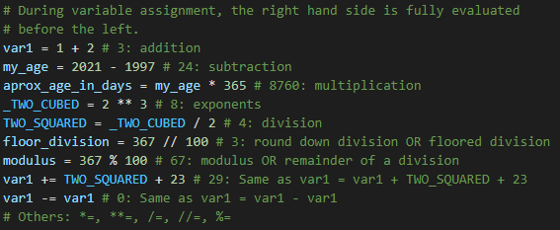
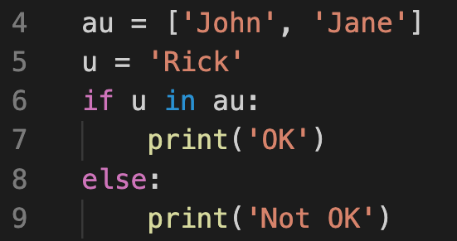
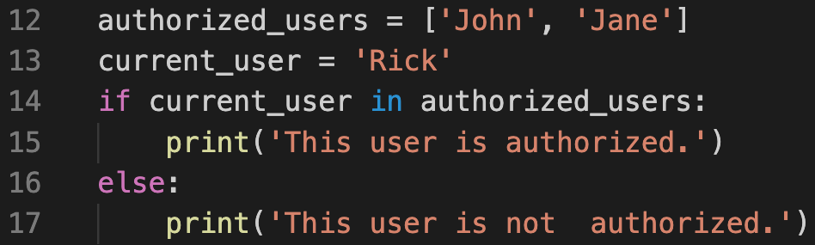
Variable Assignment & naming
Variable assignment is done via a `=` and a variable is something that holds a value. Variable names cam be anything, but they should start with an alpha character or underscore and should follow a snake_case convention.
Please note python is only as readable as you make it:
Notes:
So lets quickly define a variable and explain how we assign them.
A variable is something we can use to point to a value.
In the top left we create a bunch of variables. Anything on the left of a equals sign above is a variable. They can be named anything but we try to make them snake_case and they should start with an alpha character (A B C character). Also, do not overwrite reserved words such as `print`.
Sometimes it’s hard to know what a reserved word is. The IDE will often highlight a reserved word differently that a normal variable.
If your variable has a weird coloration, that may be a hint that you are overwriting a reserved word.
Variables can be created at any time, and any where. Those of you who have programmed in Java or C++ may understand this but if Python is your first language, just ignore this comment.
I also want to show you the basic math operations we can do. Math is only a minor part of overall programming, but a lot of convenient basic math functionality is built in. Take a second to read through the math expression above (give 40 seconds).
Before taking questions, I want to point out the all-in-one operations/assignment operators. You can play around with these during the first programming problem.
And one final note, variables can be named anything, but be “explicit”.
What does `au` & `u` stand for in the above? What am I outputting to the user?
Does it become more readable if I do this? [Show second screenshot].
Give meaningful variable names so you can read what the code does (but you don’t need to be excessive). `users_authorized_by_ad_group_us_usac_235` would be excessive.
Questions?

Slide 8
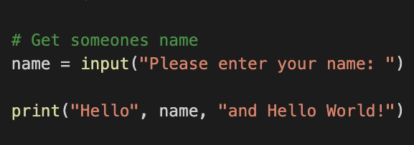
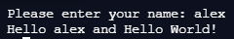
Problem 1 - Hello world! (and simple I/O operations)
Comments
Anything after a # on a given line is considered a comment by the interpreter.
Input from terminal
Syntax: input(”Message to user”). Will return what the user enters as a string.
Output to terminal
Syntax: print(“Message”). Outputs whatever is passed to the print statement to the terminal. All objects (such as strings, numbers, Booleans, etc.) can be passed to a print statement.
Notes:
So lets start programming problem 1 and get you used to the code along problems. Take a second to read over the first programming problem.
Lets understand some basic syntax which most programming languages will start you off with.
Comments -> Text the python interpretor will ignore. Comments are for you and future readers of you code to understand something that provide no functionality to the code itself. Similar to comments in a Word document which are unseen if you print the Word document.,
Input() -> We use this to get text inputs from the user. The string/text we put inside the parathesis will be displayed to the user, and cursor will remain for the user to input text. After the user inputs text and hits enter, the inputted text (without the label) will be stored within our variable.
Print() -> This is one of the most used pieces of syntax for a python programmer. This will print the text within the parenthesis to the user and then move the cursor to a new line. `print` can take many variable arguments and it will by default apply a space between each thing you provide. (This separator as well as the new end line can technically be overwritten).
Try finishing program problem 1 (15 mins, the problem should be quick but I want to make sure people get it running properly and get used to the breakout rooms). Do you have any questions? Try experimenting with the `input` and `print` statement. We will come back in 15 minutes.

Slide 9
programming problem 2
Notes:
Okay, programming problem 1 may be a little too easy compared to those coming up.
Take 3 minutes to read through the next programming problem. You shouldn’t solve it just yet but just read through the comments so you understand what you will have to do throughout this section.
We are now getting into territory where I expect more questions, raise your hand at any time. If you want to get the most out of this hack than make sure to ask all the questions that pop up. If you have the question, someone else probably does as well.

Slide 10
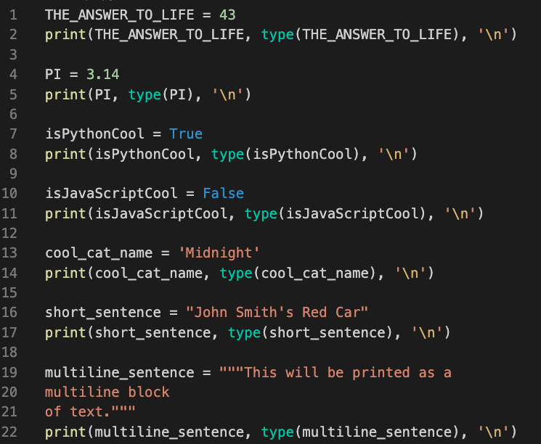
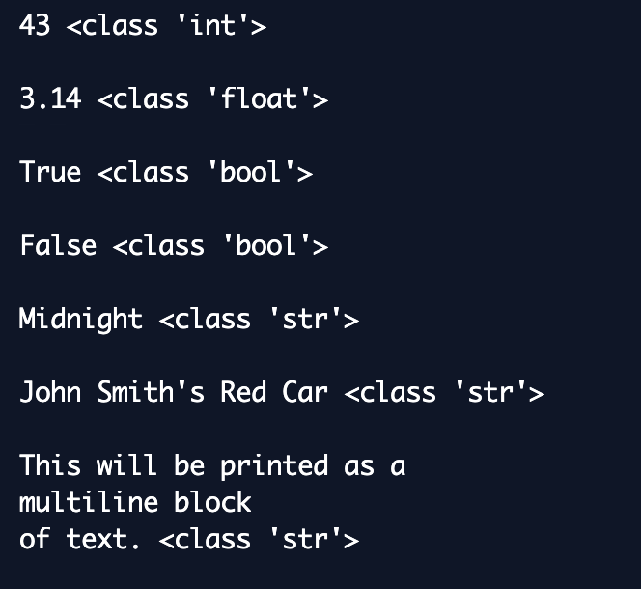
understanding types
Four of the Primitive Types:
Integers - Used to represent whole numbers. Can be positive or negative. Python integers do not have a max size.
Floats - Represents floating point numbers such as decimal numbers and rational numbers. Can be positive or negative. Python floats do not have a max size.
Booleans - Booleans can only be one of two values. `True` or `False`. Useful for conditional and comparison expressions.
Strings - Used to store words or character. Can be created by putting characters inside, single, double, or triple quotes.
Notes:
First lets understand types. There are “four” primitive types in python. Thing of these as four different types of values we can work with.
Notes:
You shouldn’t use `type()` in your code, I am just doing it to prove what I am saying. Basically, `type` will take whatever is inside the parathesis and return the object type python sees it as.
`\n` is an escape character for a new line. Escape characters are how we can tell the computer to do more than what the keyboard knows. Have you ever asked how Microsoft Word goes to the next line when you hit enter? It hides a new line character in there.
1) In python there are two different types of primitive numbers we can work with. The first is integers. Integers are whole numbers [-2, -1, 0, 1, 2]. Python can work with any integer size unlike a lot of programming languages which has a max integer size.
2) The second type of number is a float, floats are anything that has a decimal value. 3.0 is a technically float vs 3 is an integer. Python can handle converting floats and ints interchangeably so don’t worry about mixing and matching them in your code.
3) The third type is called Booleans. Booleans can only be True or False. If your question can be answered in a yes/no, true/false, on/off, fashion then a Boolean is the tool for the job.
4) We have used strings already but lets explain them a little more in depth. Strings are text surrounded by single quote, double quote, or triple single/double quotes. Single and double quotes just make it easier to use a quote inside the string. Triple quotes allow us to do multi line blocks of text. I would not recommend using triple quotes as their main purpose is to serve as doc strings which I will not get into.
Everything we write it technically text, but strings store text for us so we can pass it around or manipulate it.
The last one I don’t show is `None`. It implies nothing and is useful for creating a label that you may use later.

Slide 11
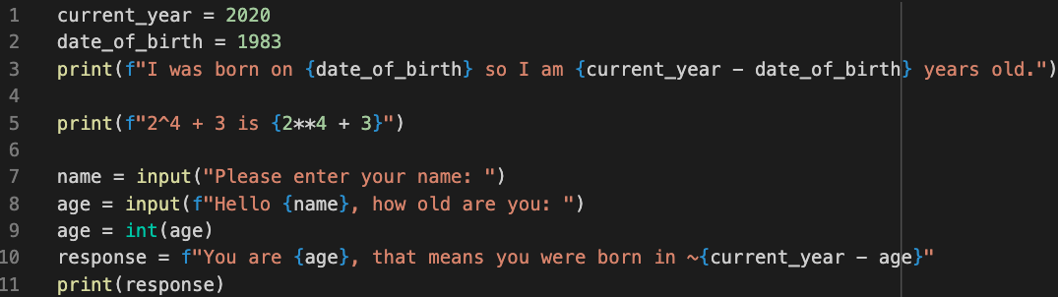
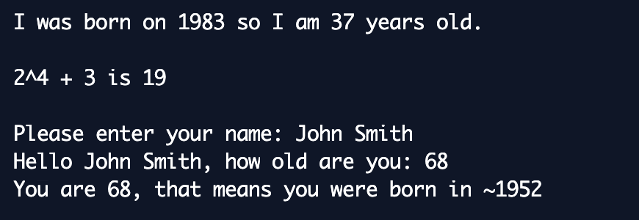
String Formatting
f-strings – quick, simple, and easy to read:
Notes:
Something we can do in Python is called “string formatting”. This allows use to inject variables into our strings/text before we use them. In this case we can use string formatting to put variables in our string before printing them.
Note, the `f` before the string turns it into a f-string/formatted string. Python will then look for curly brackets within the string and it will evaluate the code within the curly brackets and plop it in the string.
We can print variable contents this way, or we can even do math in our strings.

Slide 12
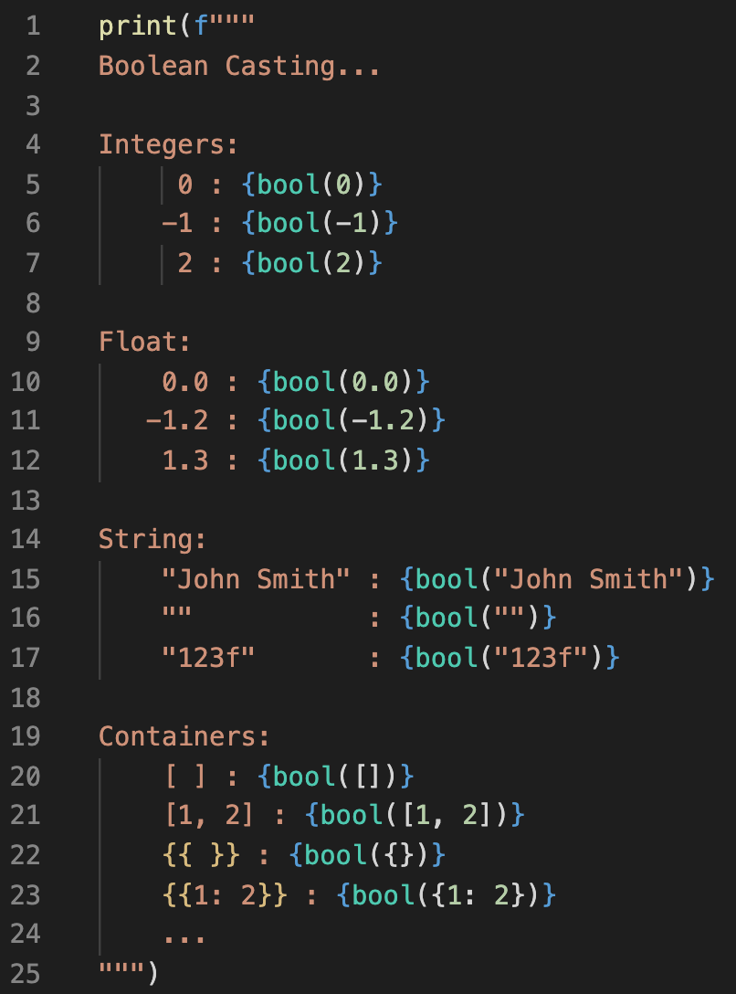
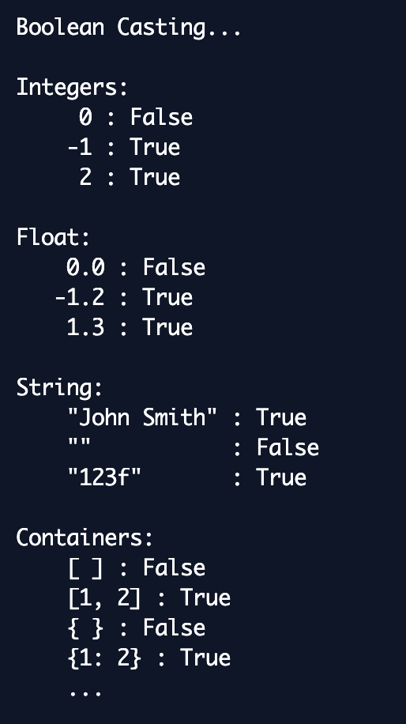
Truthy and Falsy Types
Truthy or Falsy/Falsey are the terms used to represent non-Boolean objects that may still have Boolean values.
Truthy: Something that evaluates to True Falsy: Something that evaluates to False
Type | Values Considered True | Values Considered False
Integer | Anything Else | 0
Float | Anything Else | 0.0
String | Anything Else | Empty Strings
Boolean (Doesn’t use Truthy/Falsy Nomenclature) | True | False
List (as well as other containers) | If the container containers members it is True. | An empty container.
Notes:
So, a Boolean is True or False, but as we program, python will treat different objects as True or False depending on its contents. We call this Truthy Falsey.
Let’s force types to become Booleans and see how python treats them based on their values.
If you are holding 0 pies than technically you aren’t holding any pies at all (Falsey).
Why this slide is important will come next as I explain branching.

Slide 13
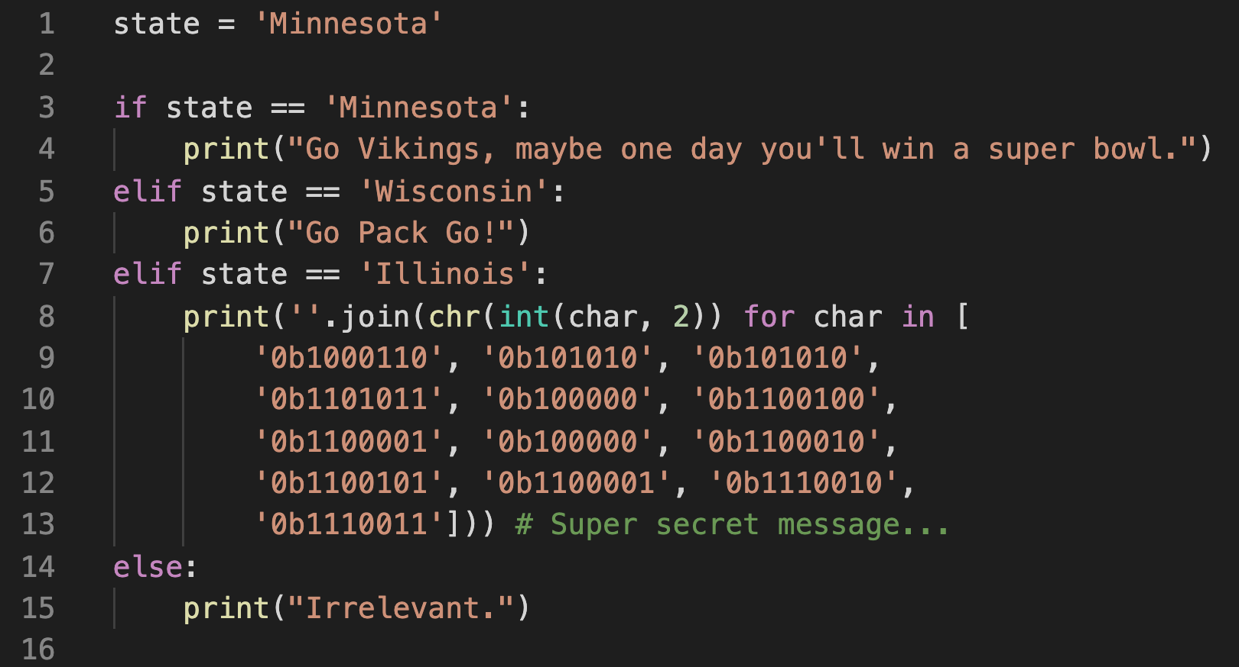
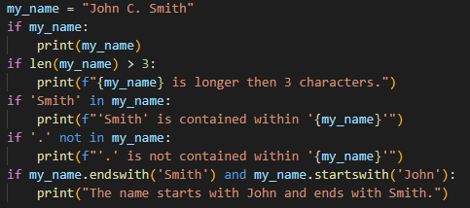
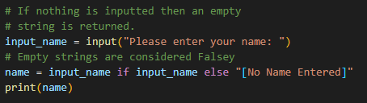
BRANCHING
if, elif, else: Branching allows programs to make decisions on what to do based on a condition. Common operations used in if statements include: ==, !=, not, and, or, in, <, <=, >, >=
Ternary: A shorter way to write a simple if-else statement.
Notes:
Nows a good point to remind you to raise hands if you have questions and don’t be afraid to ask to go back a few slides. As I said, the chicken or egg dilemma is real. If you want to go back a couple slides to double check something, just raise a hand.
Okay, we can take a users input and print stuff to the user. We understand basic types. Now lets get start with Artificial Intelligence (in its primitive form).
Branching is a way for our code to do certain actions based on our current state. I can’t eat pie if I do not have a pie. Maybe I want to perform different code based on what the user inputs.
From math you may know operators such as `+ - / * < >`, python can use those but it can also use a few more `==` & `!=`.
We also have `or` and `and`. “Or means, if A or B or C, then we will perform an action.” “And means if A and B and C are all truthy, then we will perform an action.”
An `if` evaluates the contents to the right of the `if` statement. If the expression is truthy then the following block of code will be run.
`elif` will run if and only if the above `if`/`elif` does not run. Its short for “else if” and means “If the above statement is not True, then see if this statement is true.
`else` means “If the above if statement was not true then run this code”. `else` and `elif`s are optional. You can only have one `else` per `if`/`elif` chain. Think of it as a catch all.
The left will short circuit, the right will evaluate all if statements regardless if on is true.
Lastly, I am going to show something called a ternary which is a nice way to one line an if else statement. Just memorize the normal if statements, the ternary isn’t anything super special.

Slide 14
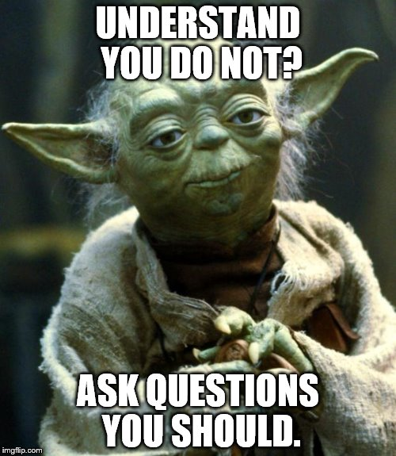
Finish programming problem 2
Questions on anything so far?
Notes:
Any questions? If not, go to the breakout rooms and work on your problem for 15 minutes. You can ask for help from the developer stationed in each breakout room. After 15 minutes I will call people back, walkthrough a possible solution, then may give a quick 5-minute bathroom break.
If topics up to this point are not clear, future ones may be confusing.

Slide 15
programming problem 3
Notes:
Start of programming exercise 3. Take a look through the problem to see what you are getting yourself into.
I need 4 volunteers, all must have mics.
Looping, try except, list.

Slide 16
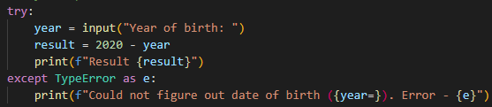
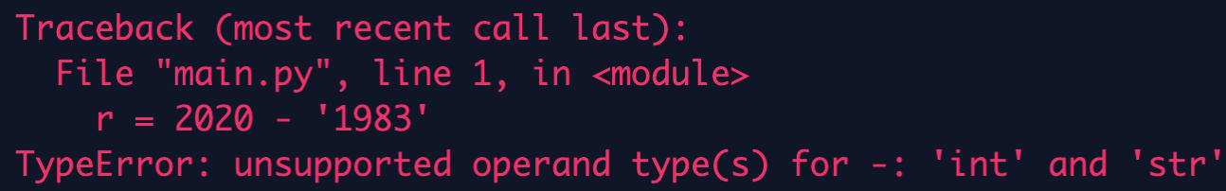
Try/Except (or Try catch block)
Used to catch exceptions/errors that occur while the program is running:
Notes:
You will probably encounter an error during your programming, so it is important to know how to read them.
It can also be useful to know how to prevent the error from crashing your program.
Exceptions will show several lines that lead up to the error itself (traceback), the most recent line will be at the bottom.
You read a traceback by starting at the bottom and reading up till you find the line that applies to you.
Often tracebacks will include lines from files that you have no control over so look for the first traceback which is from a file you coded.
By reading the traceback we can figure out what we need to catch exactly in order to prevent the program from crashing.
By catching it we can allow the program to continue (if we want) and we can provide a message more useful for debug.
You can chain exceptions and can catch a broad exception but this could cause your program to fail silently which you don’t want. See the example code to see how to chain exceptions.
_______________________________________________________
How to read an error traceback.
When an exception occurs, the code stops. Often we don’t want to do that.
Explain how to read a try except top down.
How to list multiple exceptions
Better message to show why we would catch it.
Don’t fail silently (i.e. broad except)

Slide 17
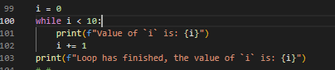
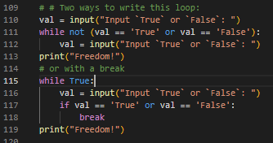
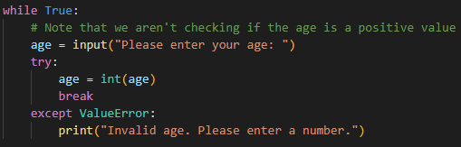
While Loop – intro
Used to repeat code while a certain condition is True
Sometimes we like to do infinite `while` loops and manually `break` out.
Notes:
Code can get long quick especially with repetitive operations. For that reason, programmers prefer to stay DRY (Do Not Repeat yourself) and use loops/functions. First, we will cover `while` loops and after some high-level concepts we will learn `for` loops.
Remember how we would enter an `if` statement if the expression on the right side of the `if` statement was Truthy? A `while` loop does this same thing except it will keep repeating the code until the expression changes to something Falsey. If the expression was Falsey to begin with, the loop would not be entered.
If the code within the loop fails to do anything which would alter the evaluated expression, then you risk entering an infinite loop which can be exited with a `Ctrl+C` but could cause some nasty issues depending on where your code is running.
There is a better loop called a `for` loop but we need to detour a little before I can better explain a `for` loop.
On the next slide I will walk through a detailed example of how to convert repetitive code into using a loop.

Slide 18
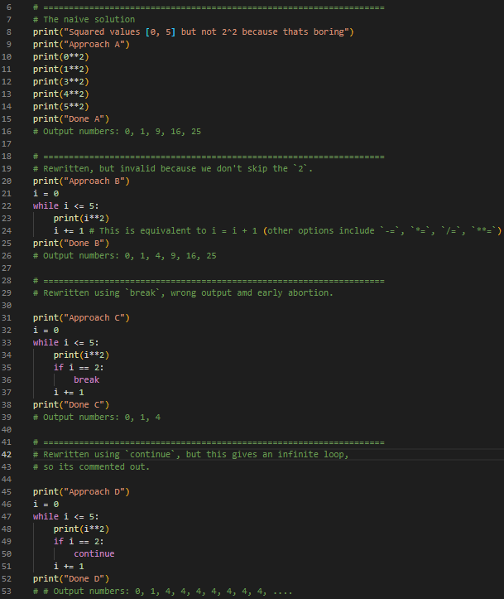
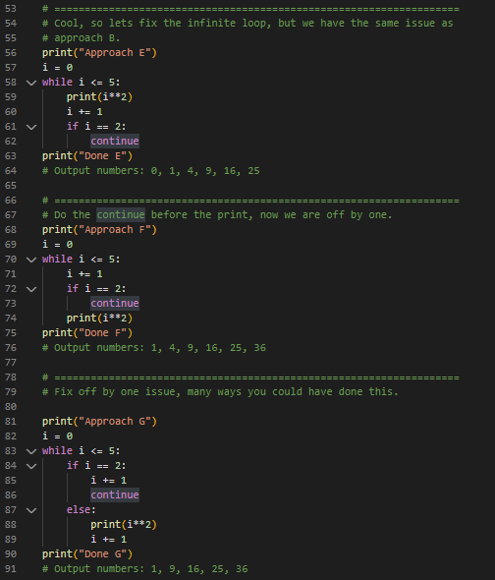
While Loop – Cont.
`continue`
vs
`break`
Notes:
Time to walk through a detailed example. I am sorry if this is a little rushed. I will try to hover over each solution to give you time to see what is wrong with it.

Slide 19


Looping Detour - we will return eventually
or conspiracy theories?
Notes:
Let’s take a breather. Any questions?
Before diving into `for` loops I want to take a high-level detour to explain some key concepts about what is happening under the hood.
Some of the things I talked about up to this point I didn’t cover in the detail I wanted.
The next few slides may come from and suffer of the chicken and the egg problem. I need to teach stuff using concepts you don’t know yet.
Also, the next 4 slides contain zero code that you will need to code yourself or remember. The goal of the following slides is so that you know what's happening at a high level so you may obtain enlightenment in the future. If the following slides go over your head don’t worry. It won’t inhibit the rest of the hack in any way.

Slide 20
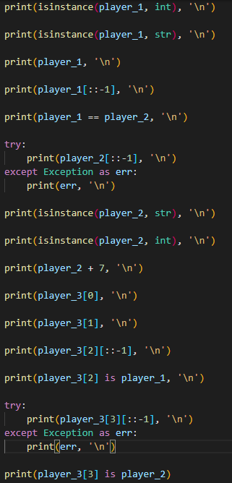


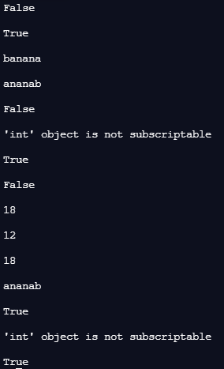

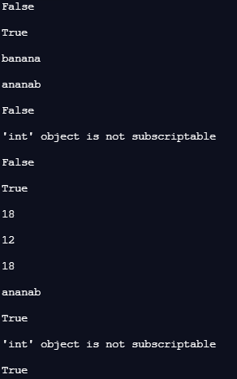

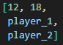
Everything is an object
Always has been
It’s all objects
player_1 = Sunny
player_2 = Leo
player_3 = Adam
Notes:
So first I need to explain the concept of objects. For this I prepared a little game, although it’s scripted.
When we define values and assign them to variables, we are actually creating something called an object.
`index = 2` is actually creating an integer object and that object has a value `2`. The object itself is actually the brains. I have 3 players and 1 guesser. Imagine each player has something in their hands. The player is the object (the brains), the value they hold is just something they can give us information about.
Please listen to the conversation. I will be asking the players questions. As I ask the question, I will reveal the code on how to ask the computer the same questions. Focus on the chat first, and you can read through the code after.
My goal for you is to understand that even the primitive types are showed earlier are values wrapped with intelligent objects.

Slide 21
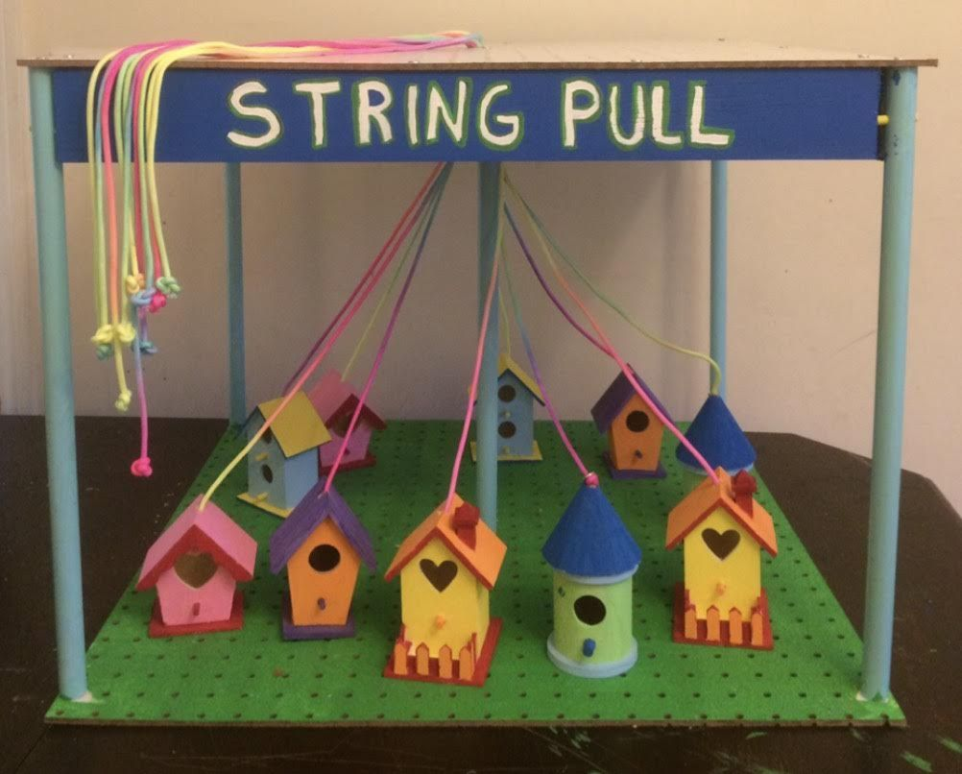
References – Where does this string go?
Notes:
So, if everything is an object, the next thing to understand what a variable actually is. To do this, picture the game above.
You can tug on a rope but you have no idea what bird house it is connected to till after you tug the rope. Keep this picture in your head.

Slide 22
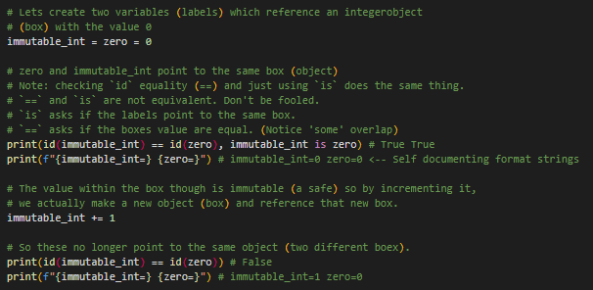




DETOUR – References (Immutable)
immutable_int
zero
Notes:
A variable is not an object. Objects exist on their own. A variable is just a named rope we tie to that object so we can use it in our code (it is a reference). As I explain these references, I will also introduce the concept of mutability (the ability for an object to change) and immutability (the inability for an object to change).
I will also explain the different between `is` and `==` which you will probably encounter on your own and I want to prevent you from thinking they are equivalent.
Immutable types in python include: Integer, Float, String, Boolean, FrozenSet, Tuple (basically all primitive types and a couple containers).
Lets say a player was holding a pie. (I like pie.) A mutable object (player) would give me a slice of the pie if I asked for it.
An immutable player/object would have the pie encased on a box of clear epoxy and say they can’t give me a slice of the pie.
Let’s show how python works with integers (immutable objects) with some example code.
Note my use of `id` and `is`. The two statements within the first print mean the same thing. Whenever an object is created, it gets assigned an ID. `is` checks if a label references the same object id; whereas `==` is checking if you objects are the same value. If I had two $5 in my pocket, their value is the same, but they are not the same object.
Now what happens if I did something like increment the label? Well, it actually creates a new object and moves the label/string to attach it to the new object.

Slide 23
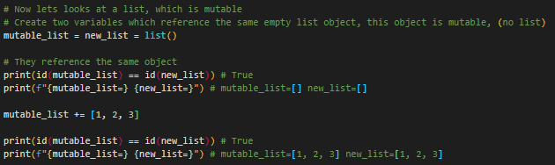

DETOUR – References (mutable)
new_list
mutable_list
Notes:
Okay, so if that’s how immutable objects are treated. How about mutable objects? To prove this I am going to use a list which I will go more into detail in the near future.
A list is a mutable object, this means the object will let me add or remove objects from the list at any time.
Mutable objects in python include: List, Dictionary, Set
Let’s use similar code to before to show what is happening under the hood for mutable objects.

Slide 24
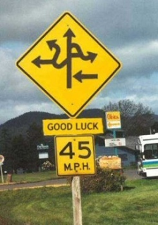

Over complicated Detour over
Notes:
The coding problem doesn’t directly use any of the knowledge I just explained so please move it into your cranial archive so you can use it to better understand some up coming concepts. If you didn’t understand the last few slides, then don’t worry. It’s not that important in the grand scheme of things.
We will take a short break because these concepts are good to brew on. Get a coffee, go to the bathroom. See you in 5 minutes.

Slide 25
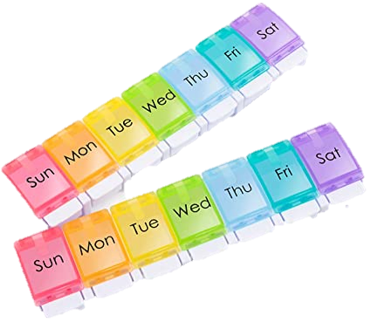
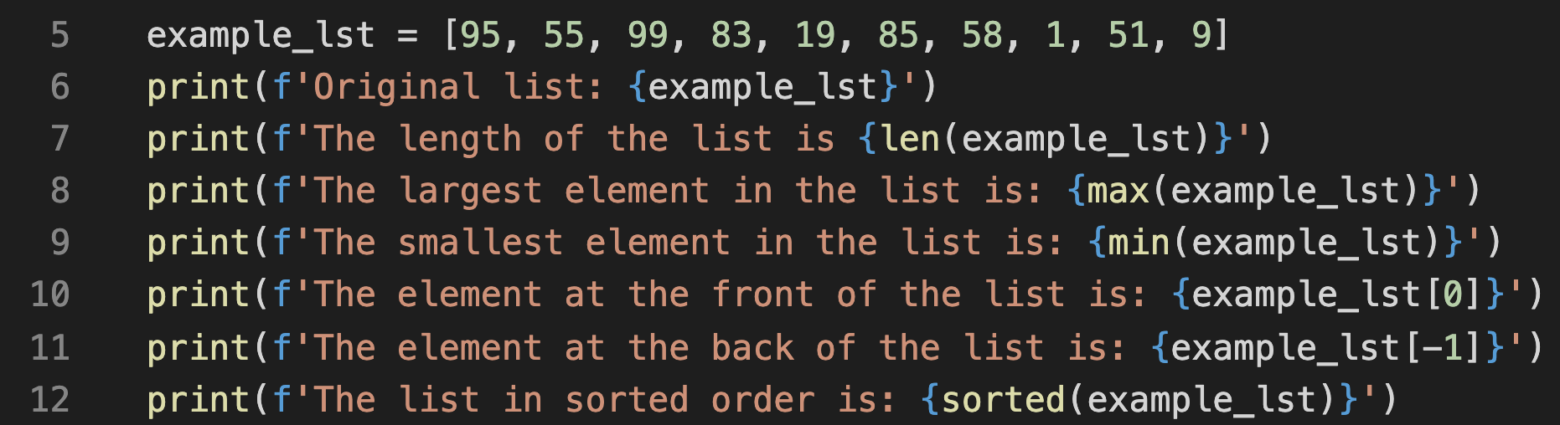
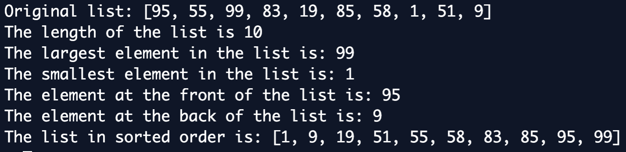
Containers – LisT (introduction to iterables)
[ , , , ]
Mutable data structure used to store objects and denoted with square brackets: [ ]
It is iterable (important for what comes next)
Can store any number of any type of objects, including other lists:
A `list` is an `object` which supports lots of convenient functionality and items can be retrieved based on a 0 index:
Notes:
Back to meaningful information that you will actually get to work with in the code along problems.
Containers (also called data structures) are objects and hold many other objects.
The first object, and one of the most important. Is the `list`. I have used it a few times up to here but now I can actually go into more detail.
A list is a mutable data structure denoted with square brackets. I emphasize square brackets because other data structure will use other types of brackets.
Being mutable means, we can add ore remove object from the list at any time from anywhere. Lists can be any length and they can also contain any type of object at any time, including other lists. They are also ordered.
Lists are iterable objects. This means that the object has knowledge on how to walk over each element it contains. Tis will become more transparent on the next slide.
We can easily print lists like printing any other variable/object.
For the length of a data structure, python provides the `len()` function.
Python also provides some convenient functionality we can use on iterables such as `len`, `max`, `min`.
We can access an element within the list by giving its index from the left (i.e. how from the left most element is the element you want to get). This is 0 based and can sometimes lead to an off by one issue that many programmers face. Given a list, we add square brackets after it to `getitem` using the desired index. If you see square brackets in code, it is either a `list`, `getitem`, or `slice` ([::-1]). A slice is what I used to print a string in reverse during the game.
Python also provides a function to print iterables in sorted order. The `sorted` function will not change the list. (There is a `sort` method that can do that though). I will not get into it, but you can also change how the sort works by providing a `key`.
Time to learn one of the most important data structure in python. This will be needed before we understand what a `for` loop is. I haven’t used/hinted this data structure several times already but this is the first time I will explain it in detail.
Elements can be inserted anywhere within the list (beginner, middle, end).
An iterable is something that we can iterate over. (Iterate: to say or do again or again and again)
Containers are any object that holds an arbitrary number of other objects. Generally, containers provide a way to access the contained objects and to iterate over them. Python does not enforce that a list must contain all of one type of object. More explanations within the Examples if the git repo.
Lists (and other containers) use 0 based indexing. This can be confusing for those new to programming and often leads to “off by one errors”. With practice these go away but just keep an eye out for them.

Slide 26
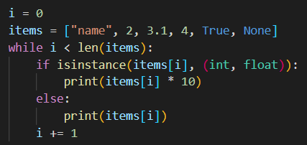
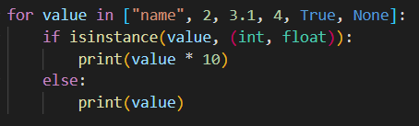
`For` loop
While Loop: Used to repeat code while a condition is true.
For Loop: Goes through an iterable and performs the indented actions on each element of the iterable.
Notes:
Sooooo remember I said we would get back to loops? While we are finally back to talk about the more useful of the two loops, a `for` loop.
A `while` loop repeats the indented code while a condition is true.
A `for` loop iterates over an iterable and performs the indented code for each item inside the iterable.

Slide 27
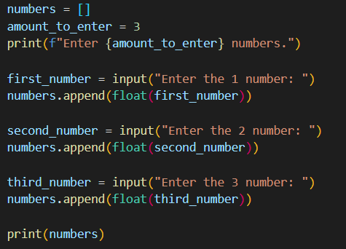
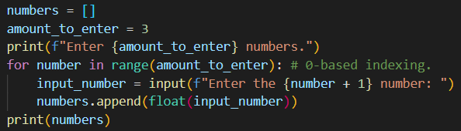
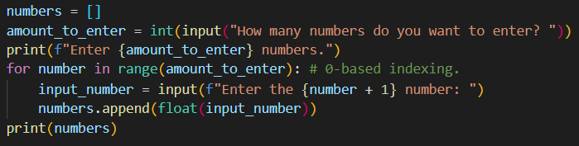
`For` loop Cont.
Where you use a `for` loop you can use a `while` but `for` loops are often cleaner.
Let me show why we like to obey the law of three and why
the above solution is so much better than the one to the left.
Notes:
`for` loops are very commonly used so I want to go over a couple examples.
First I want to train your eyes. As programmers there two important principles we follow.
DRY: Do Not Repeat yourself, reapting code makes the code longer, harder to read, and the duplicates may drift from each other.
The Rule of Three:
If do something once, that’s perfectly fine.
If you duplicate that thing once (two instances total), that’s fine.
If you duplicate something two times (three instances total), refactor (change) your code to not duplicate code, because odds are you will do it a fourth time.
Take a second to read through the code on the left. See what it does and notice the duplication. (2 minutes)
Now let’s see how I would get the same code with a `for` loop. Take a minute to read through it. I will explain `range` after you read the code.
Note, integers are not iterable by default. In order to loop `x` number of times, we must convert the integer into an iterable using the `range` function. Just put the number of times you want to iterate inside the function, and it will iterate from `0` up to (but no including) the number within the range.
The reason we like the law of three, is not I can input any number of numbers with minimal changes to my code.

Slide 28
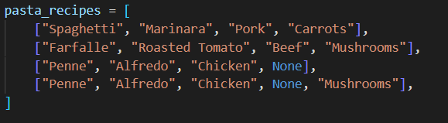
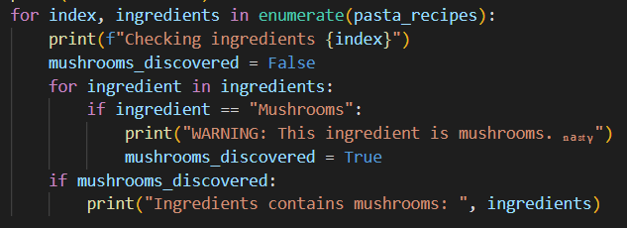
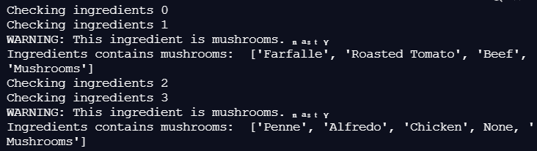
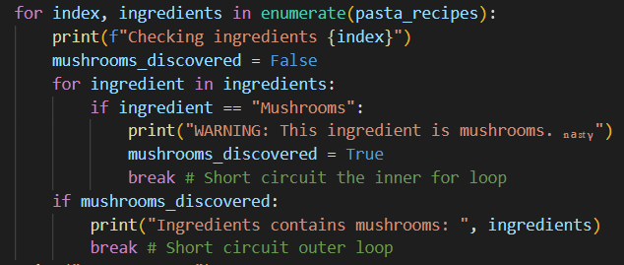
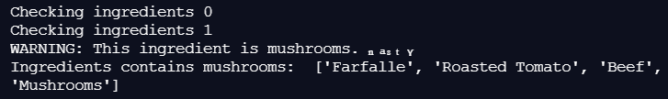
`For` loop `break`
A `for` is great, but sometimes we don’t want to let it finish iterating. Thus, we have we can `break` just like we could with the `while` loop.
Notes:
So a lot of times we will work with nested lists or nested data structures of some sort.
To work with that, we need to work with double `for` loops. In this example I will show a double `for` loop. I will also show how `break` comes into play.
First, take a couple minutes to read through the code and understand the output.
The code iterates through each recipe and prints any recipe that contains mushrooms.
(enumerate is a function which will take an iterable and return the index of each element along with the element itself).
Let’s theoretically say I got this list of pasta recipes from a co-worker. Let’s also theoretically say (just for the sake of argument) that if a single recipe contains mushrooms, I no longer trust their cooking skills and want to throw the entire recipe book away.
If you did this with your hands and a real book, would you keep reading after you found the first recipe with mushrooms even though you will toss it?
No, you would toss the book at that time.
So lets make our code more efficient, and let it stop iterating if it ever encounters mushrooms.
Take several minutes to read through the code and try to understand it. Raise a hand if you have questions. I will try to explain it after everyone gets a chance to read it.
This could be made cleaner using `in` for the second `for` loop but I want to show how `break` only effects its direct parent loop and not any higher-level parent.
When I say parent, think about your parent vs your grand parent. One is 1 level up, the other is 2 levels up.

Slide 29
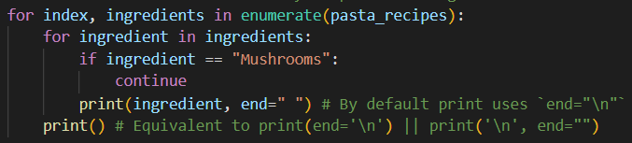

`For` loop `Continue`
`break` is useful but `continue` also has its benefits.
Notes:
Okay, so `break` tells python to stop reading.
Think of `continue` as “stop reading this page and just go to the next one.”
Let’s theoretically *cough* say I trust my co-workers cooking skills a little more so instead of not doing any of the recipes, I just want the recipes without the mushroom ingredient. `continue` can help me do that.
Note: up to this point we just used a print statement with variable arguments. The `print` statement also excepts some keyword arguments which allow us to change how the `print` acts. I do this to prevent the `print` from creating new lines on its own.
Any questions?

Slide 30

Containers – TUPLE
( , , , )
Identical to a list; except for:
Defined with () instead of [].
Objects cannot be added or removed after creation.
If an element is a mutable object, then that object can alter itself but immutable objects can’t be changed.
Immutable Objects: Integer, Float, String, Boolean, FrozenSet, Tuple
Mutable Objects: List, Dictionary, Set
Tuples are used under the hood when we do multiple inline variable assignment.
Notes:
Before being able to finish the coding problem. You will for sure need to understand one more type of container/data structure in Python, but I will teach all the basic ones.
The next container I will cover is a tuple. You probably won’t use a tuple often (at least you won’t notice them).
A tuple is very, very similar to a list with the minor difference of using parathesis instead of square brackets and the major different that it is IMMUTABLE.
After a tuple is created, we can not add, remove, reorder, or swap out an object within the tuple.
A mutable object within a tuple can change itself which I will show on the next slide.
Tuples are used under the hood when we do tuple unpacking which I will show on the next slide (and which you technically already saw in the `for` loops).

Slide 31



Containers – TUPLE cont.
( , , , )
Tuples are used under the hood when we do multiple inline variable assignment.
Tuples can be used basically the same as we use lists (except for assignment):
Notes:
Tuples are used under the hood when we do multiple variable assignment. The right-hand side is actually a tuple, and the left-hand side tries to split the tuple into parts and turn it into variables.
Tuples can be used it basically the same as a list except if we try to change the tuple it will fail.
The bottom line on the left will actually work though (the code just short circuited in the screenshots).
Once an object `id` is inside a tuple, that `id` can’t change, but if we can change the object without changing the `id` then we can get away with it.

Slide 32




Containers – SET
{ , , }
Denoted with `{}` a `set` is an iterable container which will only hold one of each value (see example to better understand). Order is not retained but adding/removing elements and membership checking is instant. O(1). Only Immutable objects can go in a `set` [int, float, bool, string, tuple].
Integers technically hash relative to their value, so order was retained (don’t rely on this), but watch if I use strings:
Notes:
Sets are another container that aren’t super used but I will explain them and show a very basic example. This slide is all I will go into `set`s so if you want to know anything more, feel free to ask.
Sets are denoted with curly brackets on each side (instead of square brackets or parenthesis)
They are iterable like a list and a tuple, so we can use it in a `for` loop easily, but order is NOT retained.
A set can also not contain duplicates of a same object.
They are used for “member of checks” or “I have seen these before” checks.
“Do you have mushrooms in your fridge?” Did you apply any order to the items in your fridge when you thought of that question, or did you basically just know? Sets are perfect at those questions.
They instantly know if they have a member or not. We call this big-O notation (Specifically `set`s are O(1)). If you need to iterate through a full list to know an answer (like the max element in a list) we call that O(n) [you need to go through the whole list to know what the max is].
Big O is an average not a specific.
Other Big O options are (n^2), (n logn), (log n), (2^n). Big O is a big concept that really isn’t important to new programmers so I won’t go in much detail, but I figured I would say this much at least so you know it exists.
`val in set` is instant -> We just “know”
`val in list` is O(n) -> Worst case we need to go through the entire list to see if it contains that value, bast case it’s the first element.

Slide 33



Containers – DICTIONARY
{ : , : }
A key value store. Keys must be unique (just like a `set`). A dictionary will return a value for a given key.
Keys must be `immutable` objects but values can be anything (including other dictionaries).
Notes:
Dictionaries I use a ton and have a ton of use cases as well. This is the last data structure you need to know for the code along and also the last built-in data structure that wouldn’t require an input.
A dictionary is a key value store kind of like safety deposit boxes in a bank. A key is unique and will lead box.
The only part that fails in that analogy is that dictionaries can have nested dictionaries but other than that, the analogy is pretty good.
Similar to a set, dictionaries use curly brackets. We can add keys and values to a dictionary similar to how we would do it with lists. We use square brackets with the key inside and we assign it to a value object. Keys must be immutable like objects in a set but values can be anything.
Membership checking (`in`) is instant and checks to see if the key is in the dictionary. Similar to how a bank may be able to tell if the key belong to them or not. `in` does not look into the values.

Slide 34


Containers – DICTIONARY Cont.
{ : , : }
Notes:
Dictionaries are iterable., making it easy to work with in a `for` loop. By themselves, you iterate the keys, but dictionary objects have methods which allow us to iterate more than that.

Slide 35



Containers – DICTIONARY Cont.
{ : , : }
Notes:
Dictionaries are useful when we have lists of data points.
The top `my_data` is the same as the bottom `my_data` but the bottom helps us read the data easier. It’s also easier to save the data to a file and read the data within that file. On top of that, dictionaries give us a little more flexibility and we can easily add things like `metadata` (with is data that further explains the data you have).
You have seen `\n` up to this point which is an escape character for “new line”.
The code on this slide, if add `\u` which stand for Unicode character. A `\u` is directly followed by a four-digit sequence/hex which represents the utf-16 character you want.
Unicode characters are how get special characters like Spanish letters or Mandarin characters.
https://www.fileformat.info/info/charset/UTF-16/list.htm

Slide 36


Finish programming problem 3
Questions on anything so far?
Notes:
Any questions to this point? We are going to take ~20 minutes to try working on and finish program problem 3. After the time I will go through it myself and show you different ways I would solve it. Feel free to ask questions, we can go back several slides to explain certain concepts. Just raise your hand.

Slide 37
programming problem 4
Notes:
This section can be skipped if we run out of time (I probably wouldn’t start it without time to finish it).
Program problem 3 covered most of the important basics of Python.
The only things I want to cover now are functions, read/writing to a file, and importing. Ideally, we could cover classes which are how we can create our own objects but I do not believe we will have time for that, and I would rather hammer in the basics.
Programming problem 4 will be basically create a food shopping system of sorts. We will store a registery of the items we have within a file (json) and allow the purchasing of products. (Store a change log for when things happen [extra work]). The program will also have function to export the data into a csv file (Comma Separated Values).

Slide 38

defining functions
A function is an object that is callable. Functions are a way we can put code in blocks which is only “run” when called. We can pass data when calling the function, and the function itself can return data after it is done being run.
Function declarations start with a `def`:
Function Name: The name of your function. Like a variable name, it can be anything but don’t overwrite built in key words. Functions should be named using snake_case.
Arguments (optional): The objects/data the function expects as an input. Could be empty parenthesis for a function that takes no arguments. Arguments can be defaulted in which case they are not required to invoke the function (since they are default to a specific value) but can optionally be passed. Don’t default to a mutable object (such as a list). Arguments should be named using snake_case.
Type Hints (optional): Type hints are a form of documentation; they help programmers see what type of object your function expects for its arguments since Python does not enforce and objects type.
Doc String (optional): Created using triple quotes right under the function declaration. It’s a string that serves no functional use but helps readers better understand what your function does. Some IDEs will pull this out as well to help with “intellisense” hints.
Return Values (optional): By default, a function returns `None` after it is done being executed. We can explicitly return any object we want using a `return` statement. A function can have multiple `return` statements, but once a function returns, it will not run any further code.
Notes:
** Give 20 seconds to read. **
We have seen and even used some built in functions up to this point but I didn’t go into much detail.
See the screenshot at the top, this is an excerpt from back when I went over lists. What I want to highlight in this screenshot is the `max`. This `max` is actually a built-in function that we are invoking. If you see parenthesis after a variable, it means we are calling/invoking a function. (Technically we may be invoking a method but a method is also a function).
Functions are objects that are callable (I could do `isinstance(my_func, object)` and it would be True). Functions are ways to put codes in blocks which only “runs” when called. We can pass data to a function when calling it and the function itself can return data. The function can also change mutable objects such as lists.
We can pass data to a function and return data from a function.
Here is a rudimentary version of the `max` function that I coded. I would walk through the important parts and explain each piece.
The function name. This is identical to variable names. It should follow the snake_case standard and you shouldn’t overwrite existing keywords but the function name can be anything you want.
Next is the arguments, which are optional. Arguments are objects (or pieces of data) that we will pass to our function that the function can work with. Every comma delimited item is another argument the function takes. We can pass as many arguments as we want OR we can leave the parathesis empty for a function that takes no arguments.
By default, if you add an argument, then the caller of the function MUST pass that argument to use the function; however, we can default arguments by using an `=` symbol. A defaulted argument is no longer required to be passed. Think the `print` statement where I changed the `end=` earlier (you will see this later and I will point it out). Do NOT default a argument to a mutable object. You can do it, but the program may not behave like you expect.
Another thing you can optionally add to arguments is called a “type hint”. Python does not enforce the type of object you pass to a function, but we can add type hints as a form of documentation to show people that read the code what type of object your function expects for that argument and this can make your code more readable. Types hints provided to added functionality.
The next optional thing you can have in a function is called a doc string. This is a triple quoted string where you can further explain what your function does. Think of it as a multi line comment block. Some IDEs can extract this text when you hover over a function to show you what the function does but doc strings provide no added functionality.
Lastly I need to introduce the `return` syntax. By default all functions return `None` when it is done being executed. We can return data by saying `return` followed by the object you want to return after the function is done being run. In the example above, we are return the maximum value within the list. Once a return is hit, no further code within the function will be run.
The “body” of the function is just the indented code that is run.
________
Not sure if my analogies are always useful but I want to give an analogy of a real-life example of a function.
Many people in this call may have functions in their life but it took 9 months of development and 11 years of nurturing for them to become useful and you only get 4 years out of them.
Here is my analogy,
Imagine giving your kid a shopping list and $20 and say go to the store and by the stuff on the list. You don’t know exactly what your kid will do, but you gave them the responsibility and you have faith that they will return a bag of groceries and some change.

Slide 39



invoking functions
Invoking Functions
Variable Arguments vs Keyword Arguments:
New
New
Notes:
So I showed how to create a function on the last side and explained the parts but not how to use it.
The function on this slide is the same except to help elaborate a few points I added a third argument and all I do is print that argument.
We invoke a function by putting the function name, and then passing the arguments to the function within parathesis to the right of the function name.
The return value of the function can just be assigned to a variable like how we would assign a string to a variable before. Note, the function is completely run before the variable assignment takes place so the variable doesn’t point to the function object but it points to the object returned by the function.
When we invoke a function, its important to understand variable arguments and key word arguments.
Let me show you the different ways I could call this function. All the following methods call the function in the same manner,
On the left I could invoke the function by passing one argument because the other two arguments are defaulted.
I could call the function the same by passing all three variable arguments if I wanted (I need to pass them in the proper order)
OR
I could call the function by using the first argument as a variable argument (order matters) but address the other two arguments as key word arguments.
When using both variable arguments and keyword arguments, the variable argument must come first. (Python will error if you try to do it differently).
When using key word arguments, the order is no longer important (so I flipped them to show this point).
OR
I could pass all arguments by key word but maintain the definition order
OR
I could pass arguments by key word and completely shuffle order since order isn’t needed for keywords.

Slide 40

importing
`import` statements allow us to import objects (code) from other locations to use it in our program. We can `import` from:
- Built In Packages that Python has: `json`, `functools`, `itertools`, `os`, etc.
- 3rd Party Packages installed via `pip`: `requests`, `boto3`, etc.
- Local files (we can break our code into multiple files and import it).
Notes:
** Give time to read. **
If you use Python for a project, you will probably use an import sooner or later.
Imports allow us to import objects/code from different places.
The first list of things you can import is from built in packages.
The reason python separates objects and make us import some is that some objects and code are super useful but not used by a lot of programmers. In order to make the language as small and fast as possible, it pulls out this code into importable objects. You can just import this code if you need it.
Common built in packages include:
collections
os
sys
json
logging
functools
itertools
The second item is third party packages. These are packages that you install with pip. Basically, these are addons to Python. When you install a third party package, you can read its documentation on how to import and use it.
The third thing you can do is import code from local files. We can do this to separate our code into multiple files to make it more organized. I will go in heavy detail into this on the next slide.
To explain the different between import and from _ import _:
Import means import an object. We can also import objects that are a part of a bigger object, for example `from collections import namedtuple` vs `import collections; collections.namedtuple`.

Slide 41

importing – from local files
Code can get long and tedious if we only work with one file. Breaking out our code into multiple files can help maintain a clean code base. (IDE Demo)
Notes:
Sadly I could not bake this topic into a slide without making in confusing as hack.
In order for imports to work as we expect we need to run the code with our terminal in the right spot.
A terminal is something like cmd prompt, PowerShell, git bash, or Terminal (for Mac).
Python does imports relative to where the first file it ran and that’s where it starts looking for new .py files and new nested packages.
I need to show this in an IDE because I think screenshots will be a lot more confusing then walking you through the importing itself.
You will also get to see a few functions and how we can put them in different files as sort of “helper” code that we can use when we want to.

Slide 42




Working with textual files
DON’T DO THIS! – You risk not closing the file.
This is OK.
This is OK.
This is OK.
=
Notes:
The next topic and basically the last topic of the course, is working with files. Programming is great but a big chunk of its power comes from being able to read data from existing data sources and files.
To work with a file, we need to `open` it. Similar to how you need to open a word doc in word to work with it.
I wanted to show you the best way to open a file but if you google search how to work with files you may see the old approach so I will show you both.
** Explain how we open a file, read its contents, then close the file **
The first argument is the path to the file RELATIVE TO THE ENTRYPOINT. You can also given it an absolute path (show abs path in file explorer).
The `open` takes a second variable argument which is the mode to open a file.
By default, files are opened as `read-only`. We can change this by opening the file in a different `mode` which I will cover on the next slide. Since we open the file as read-only, the write will throw an exception.
Failure to close the file can cause issues later in the program.
The reason the top left code is so bad is because we fail to close the file if an error occurs. (I.e. we fail to write because the file is read-only).
We can fix this by doing a try except with a finally to make sure we close the file regardless of how the code runs.
Instead of the open/close syntax, we can use what’s called a context manager. A context manager will open the file and assign it to a variable using the `as` syntax.
When the `with` clause is exited, it will automatically close the file for us so we never have to fear the file being left open.

Slide 43

Working with textual files - modes
 | r (default) | r+ | x | x+ | w | w+ | a | a+
Readable | ✓ | ✓ |  | ✓ |  | ✓ |  | ✓
Writable |  | ✓ | ✓ | ✓ | ✓ | ✓ | ✓ | ✓
Default Position: start | ✓ | ✓ | ✓ | ✓ | ✓ | ✓
Default Position: end |  |  |  |  |  |  | ✓ | ✓
File Must Exist | ✓ | ✓
File Mustn’t Exist |  |  | ✓ | ✓
Truncate (Clear File) on Load |  |  |  |  | ✓ | ✓
Always Write to EOF |  |  |  |  |  |  | ✓ | ✓
 | t (default) | b
str (io.TextIOBase) | ✓
bytes (io.BufferedIOBase) |  | ✓
Notes:
When we open a file, it defaults to a certain “mode” which dictates what we can assume and how we treat the file.
The default mode is `rt` which means open the file as read-only (r) and read text (t) from it.
Often, my go to mode is `w+`. Take a second to read and try to look at the example `with` clauses bottom right to see what that mode can do.
You probably won’t open a file in binary mode and binary is an advanced concept that I don’t think I should go into right now.

Slide 44
Working with textual files - modes - exceptions
 | r (default) | r+ | x | x+ | w | w+ | a | a+
Readable | ✓ | ✓ |  | ✓ |  | ✓ |  | ✓
Writable |  | ✓ | ✓ | ✓ | ✓ | ✓ | ✓ | ✓
Default Position: start | ✓ | ✓ | ✓ | ✓ | ✓ | ✓
Default Position: end |  |  |  |  |  |  | ✓ | ✓
File Must Exist | ✓ | ✓
File Mustn’t Exist |  |  | ✓ | ✓
Truncate (Clear File) on Load |  |  |  |  | ✓ | ✓
Always Write to EOF |  |  |  |  |  |  | ✓ | ✓
 | r (default) | r+ | x | x+ | w | w+ | a | a+
except FileNotFoundError: | ✓ | ✓
except FileExistsError: |  |  | ✓ | ✓
from io import UnsupportedOperation except UnsupportedOperation: | ✓ |  | ✓ |  | ✓ |  | ✓
Notes:
This slide is like the last slide but I wanted to show you what exceptions you may hit depending on how you open your file.

Slide 45



Working with textual files - Read/write iO
Our print adds a `\n` which the line already has, thus it prints `\n\n` at the end of each line.
Notes:
We need to open a file to work with it, but what can we actually do with the open file?
I can’t cover all the operations but I will cover a few important ones.
While working with files, the methods I will cover are, read, write, and using a file object in a `for` loop. A couple I won’t cover are read_lines and write_lines.
First lets write some text to a file. To do this I will open the file, then call the file’s write method and pass it the text to write to the file. `w+` will create the file if it does not exist already.
Second, I can read all the text within the file using it’s `read` method. This will return all the contents of the file as one long string.
Lastly, some files can be massive so we don’t really want to open the whole file. Instead we can read it line by line. The file object is actually iterable so we can just through it in a `for` loop and it will iterate over the file line by line so we only have a line open at a time.
Question, does anyone know why the output has a new line between each line that was printed?
(The print statement function has a keyword only argument we can use to change the end but it defaults to `\n`)
_______________
breakpoint() syntax

Slide 46



JSOn – Java script object notation
Notes:
So, I showed how to work with files and before that I show how we import code in different files and folders, but Python some pretty cool built in functionality.
I want to explain JSON which python has a built-in package that we can import to work with.
JSON strings should be fairly easy to wrap your head around if you understand primitive types, lists, and dictionaries since that is all JSON is.
JSON is a text standard in which we can use to pass data as strings/text and easily understand the data within that string.
Some valid python may not be valid JSON (i.e. a tuple as a key) but for the most part JSON can very easily be converted to Python and vise versa.
Important to know, JSON must use strings as keys. If you try to export a dictionary as json, it will try to convert the keys to strings, but when you import it again, it will be string keys.
JSON text can very easily be converted to python objects to be worked with. This makes it easy to save and load data into your program.
Can you see the similarities between Python and valid JSOn above?
I’ll show how to work with this on the next slide.

Slide 47



JSOn – working with json strings
Notes:
When working with `json` we need to import Python’s built-in `json` module (object).
This object allows use to covert objects into `json` text and `json` text into objects. It also easily allows us to dump text to a file or read text from a file right into an object.
First lets show how to work with JSON strings, then I will show how to work with files
`dumps` means “dump json to string” which converts dicts/lists to text
`loads` means “load json from string” which converts text to dicts/lists

Slide 48



JSOn – working with json Files
Notes:
Working with json files is almost just as easy. We just need to open the file, and pass it to the json module to work with.
Now we work with `dump` and `load` vs `dumps` and `loads` which we did with strings.

Slide 49

Finish programming problem 4
Questions?
Notes:
Finish up the fourth programming problem. Ask any questions you may have.

Slide 50


El Fin
Notes:
Survey of the hack to come, please leave feed back. Also if this interests you keep an eye out for more software & systems academy course via Tech Forum. I hope to do some advanced level courses that go more in depth on some cool topics.
Next on my list is a fun one called Regex.
Python3 Built-In Functions (like min, max, etc): https://docs.python.org/3/library/functions.html
If you want more practice, try the easy problems on leetcode. Just doing 1 a day or a week is a great way to get familiar with the language.

Slide 51




Next Steps
Cheat Sheet (mostly covered): https://websitesetup.org/wp-content/uploads/2020/04/Python-Cheat-Sheet.png
Checkout all the built-in python functions you can call: https://docs.python.org/3/library/functions.html
A LeetCode a week keeps the bugs weak: https://leetcode.com/problemset/all/
Abel Gladstone Mangam,
Benjamin Hubbard,
Carter Hughes,
Collin Sieffert,
Eric Walker,
Erich Mielke,
Gabe Turner,
Mark Swift,
Milo Oien-Rochat,
Nigel Boxall
Scott Larson,
John Guckenberger,
Notes:
Cheat Sheet, contains most of the stuff we talked about plus stuff we didn’t have time to talk about, thanks Blaise Thompson for sharing.
Python has a lot of useful built-in functions. You can check those out in the second link.
Lastly, want practice? Take 20 mins and do an Easy leetcode problem. Checkout the submissions to see how other people answered them.

